Slide 1
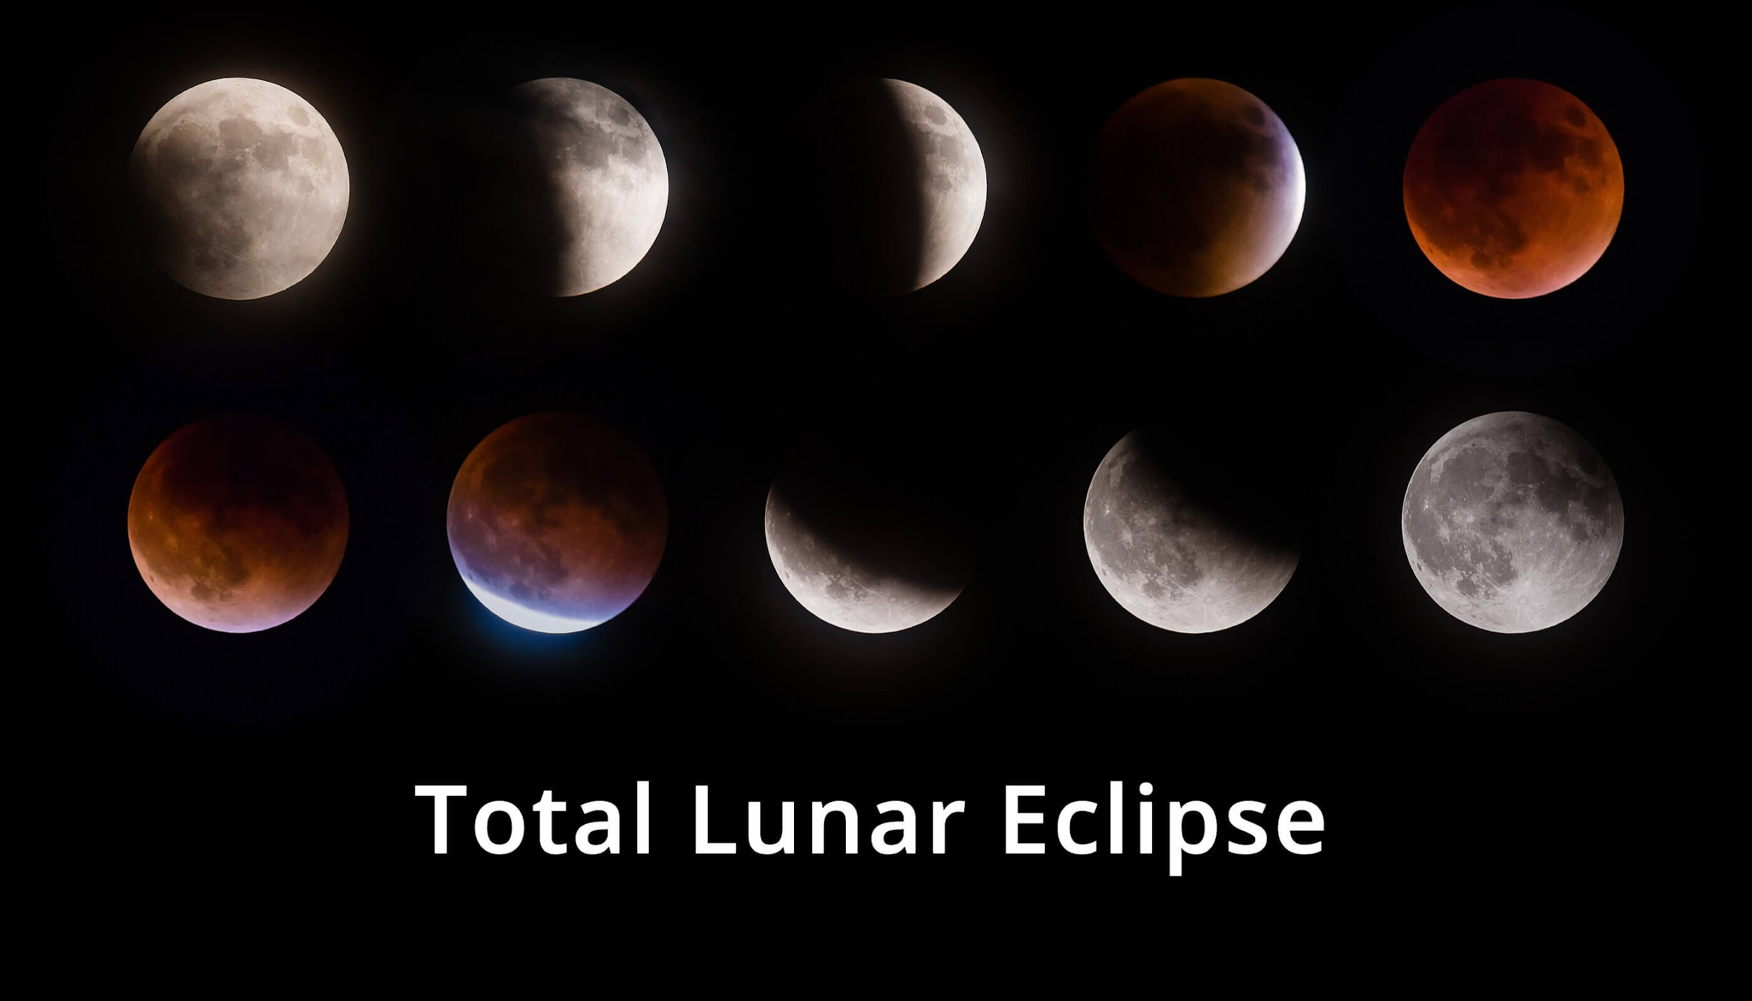
Lec 2: Lunar Eclipses
© Gerard Williger 2023 U Louisville
Diffuse vs. Point Source Light
Effect of Air on Light
Astronomy brightness scale
Orbits
Phases of Moon
Types of Lunar Eclipses
Pretty pictures!

Slide 2
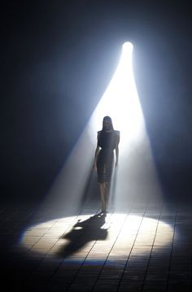

Light: Point Source vs. Diffuse
© Gerard Williger 2023 U Louisville
Diffuse light: multiple sources
-- SOFT/FUZZY or NO SHADOW
Example: light from Sun (NOT a point source)
Spotlight: almost “point source”
-- light comes from 1 direction
-- SHARP SHADOW
Example: light from one star

Slide 3
What Atmosphere Does to Light
© Gerard Williger 2023 U Louisville
1) Distorts: makes stars “twinkle”
2) Refracts: makes Sun appear "flat" at sunset – same mechanism as distortion
3) Scatters: blue light scatters more than red → BLUE SKY
4) Absorbs: no gamma/X-rays or ultraviolet=UV light gets to ground
Only optical and a little IR light get through
(5) Glows: in near and mid-infrared light)
How “greenhouse effect” works

Slide 4
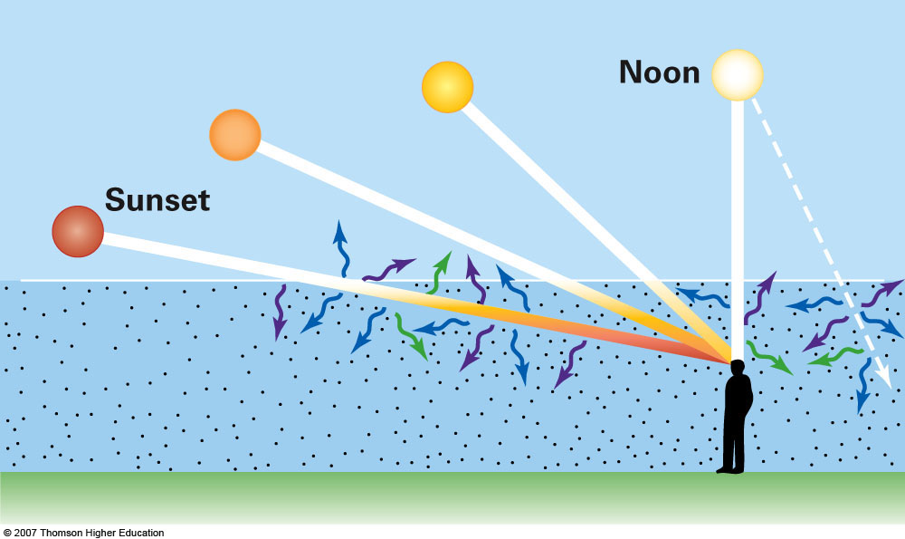
Twinkling
© Gerard Williger 2023 U Louisville
Twinkling: we look through more air cells close to the horizon than toward the zenith (straight up). So, twinkling is STRONGER close to the horizon than toward the zenith.
Why are sunsets red? Air scatters blue light more than red light. When we look through a thick layer of air, like at sunset, mostly red light from the sun gets through. The blue light is scattered to other directions.
FYI 2.8’ VIDEO: Why is the sky blue?
Blue Sky
RED
Not to scale!
Notes:
A Closer Look 4-1: Colors in the Sky.
Air molecules preferentially scatter violet, blue, and green light, causing the sky away from the Sun to appear some shade of blue. The longer the path through the air, the more short-wavelength light is lost, so the setting Sun appears orange or red.

Slide 5
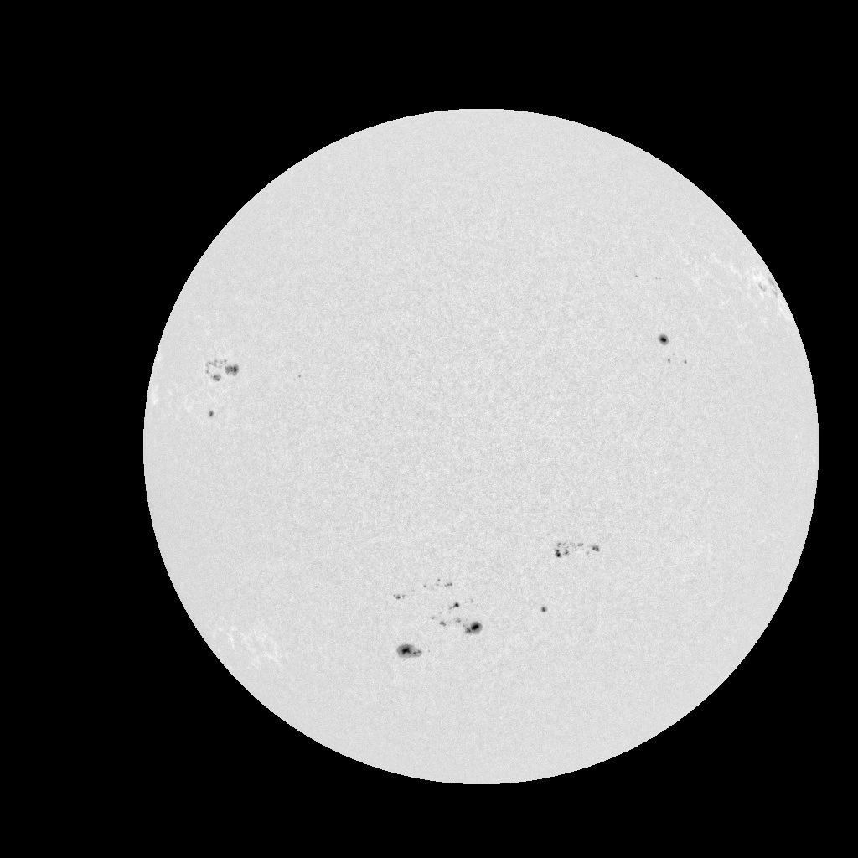
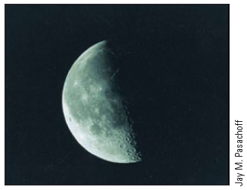

Astronomy Brightness: BIG scale!
© Gerard Williger 2023 U Louisville
Sun is BRIGHT: 400,000x brighter than Moon!
Moon reflects 5-10% of light (=dark!)
Moon appears 25,000x brighter than brightest star (Sirius)
Sirius is 250x brighter than faintest star visible to naked eye
Even 1% of sunlight = daylight on cloudy day

Slide 6
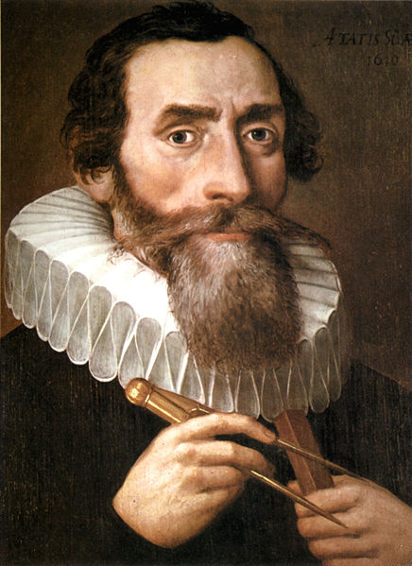
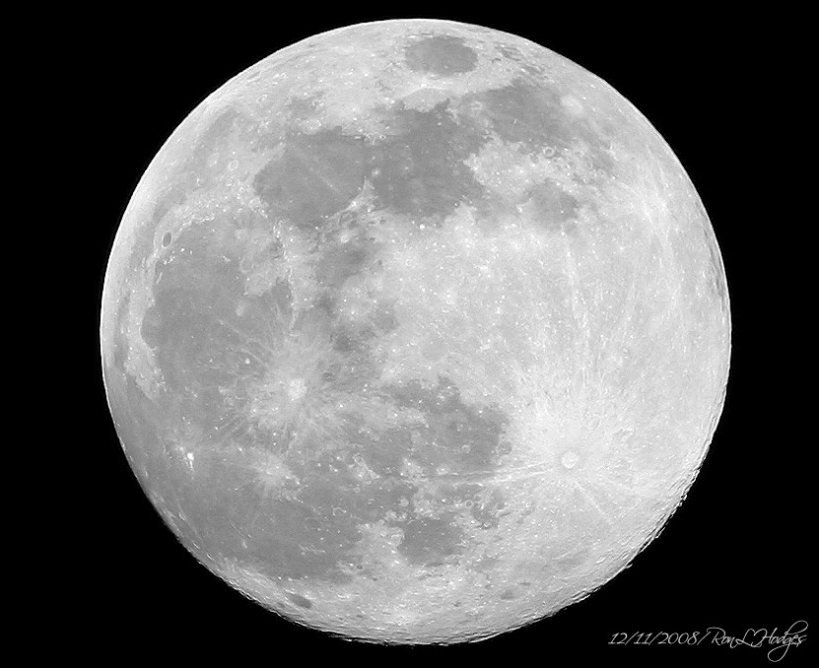
ORBITS
© Gerard Williger 2023 U Louisville
Johannes Kepler (1571-1630) used observations of planets to deduce 3 laws:
Planets move in an ELLIPSE, with Sun at one focus
Planets “sweep out” equal areas of their orbit in equal times → move FASTER when CLOSER to Sun
The period (year) squared of a planet equals its mean distance cubed
Kepler 1610
ALL objects in orbits follow these laws, INCLUDING MOON AROUND EARTH

Slide 7
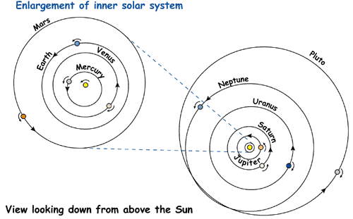
Kepler’s 3 Laws: 1st Law
© Gerard Williger 2023 U Louisville
1) Planets orbit in an ellipse with Sun at one focus (other focus empty)

Slide 8
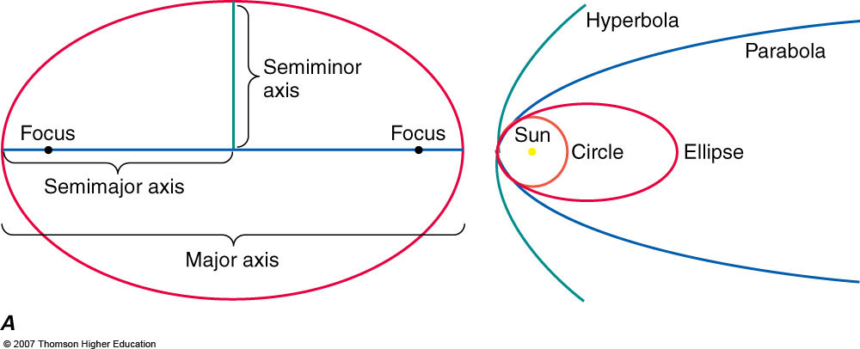

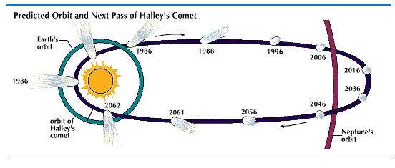
Ellipses
© Gerard Williger 2023 U Louisville
e=0.75
e>1
e=1
=a
e=0
e=0.8
eccentricity: e=(distance between foci)/2a
Circle: e=0 Earth’s orbit: e=0.017 Mars: e=0.09 Mercury: e=0.21 big ellipse above: e=0.75 Halley’s Comet: e=0.97 parabola: e=1
Based on figure from Pasachoff & Fillipenko (5th ed., 2019)
Notes:
Figure 5.14a: The parts of an ellipse, a closed curve. (right) The ellipse shown has the same perihelion distance (closest approach to the Sun) as does the circle. Its eccentricity, the distance between the foci divided by the major axis, is 0.8. If the perihelion distance remains constant but the eccentricity reaches 1, then the curve is a parabola, whose ends do not join. Curves for eccentricities greater than 1 are hyperbolas (which, like parabolas, are open curves).

Slide 9
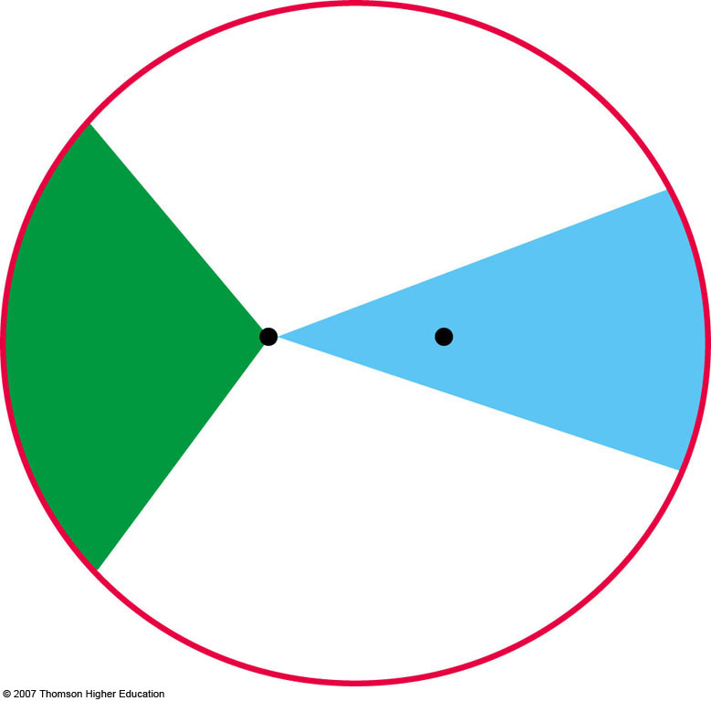
Kepler’s 2nd law
© Gerard Williger 2023 U Louisville
Radius vector sweeps out equal areas in equal time
Planet moves fastest when closest to Sun (perihelion)
Planet moves slowest when farthest from Sun (aphelion)
Is consequence of conservation of angular momentum
perihelion
aphelion

Slide 10
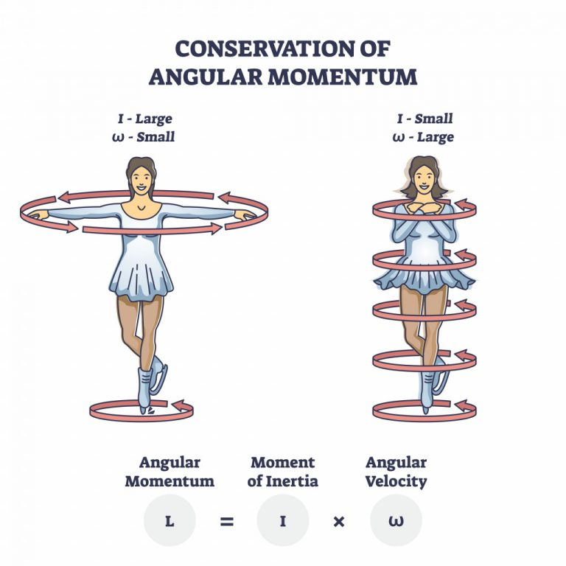
Angular Momentum
© Gerard Williger 2023 U Louisville
Spinning object tends to keep spinning with the same speed and direction till a force acts on it (like friction)
Angular momentum = mvr
m=mass
v=velocity (speed AND direction)
r=radial distance from spin axis
For simple object, angular momentum easy to calculate
Complex object (like person): have to calculate mvr for many little parts and add them up
Angular momentum depends on spin axis! (barbells)
Image credit: VectorMine/Shutterstock

Slide 11
Kepler’s 3rd law
© Gerard Williger 2023 U Louisville
Period squared “P” (in years) = semi-major axis symbol “a” cubed (in Astronomical Units = AU)
1 Astronomical Unit = mean distance from Earth to Sun
P²=a³
Examples: P_{Earth}=1 yr, a_{Earth}=1AU
Jupiter: P_{Jup}=11.9 yr, what is a_{Jup}?
P_{Jup}²=a_{Jup}³
So a_{Jup}=P_{Jup}^{2/3}=(11.9)^{2/3}=5.2 AU
Works for Earth-Moon system (just need different units)
FYI 4’ VIDEO on Kepler’s Laws

Slide 12
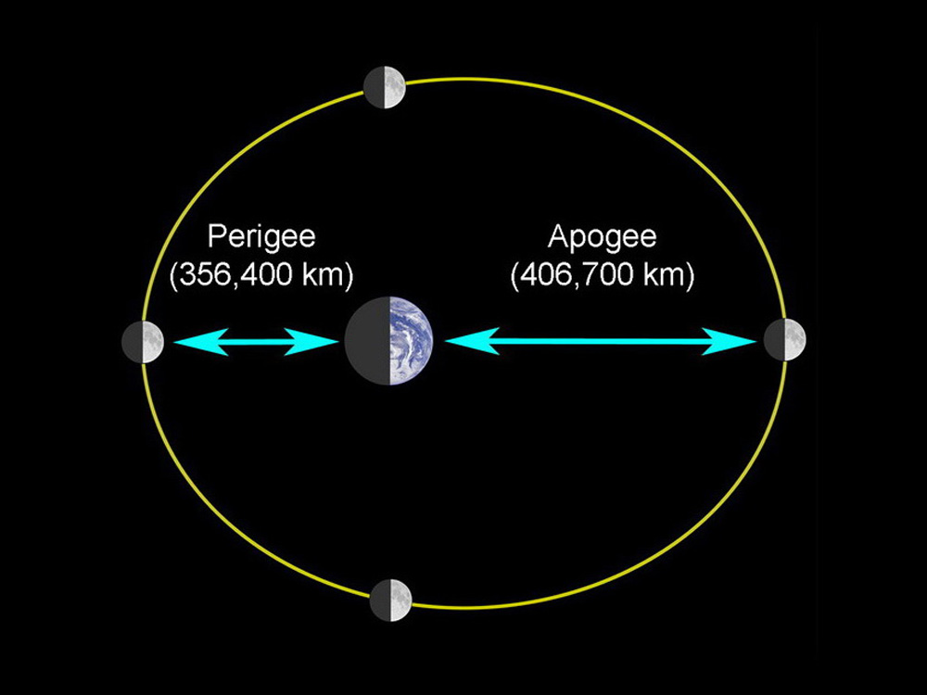
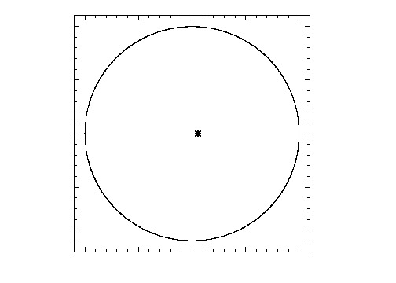
What does this mean for Moon?
© Gerard Williger 2023 U Louisville
Moon moves around Earth in an ELLIPSE
Deviates from circle by 5.5% (eccentricity = 0.055)
Near point to Earth = PERIGEE
Far point from Earth = APOGEE
Orbital speed:
FASTER at PERIGEE, 5.5% faster than average – 3880 mph
SLOWER at APOGEE, 5.5% slower than average, – 3480 mph
Exaggerated ellipse!
Earth
x
perigee
x
apogee
True scale, e=0.055

Slide 13
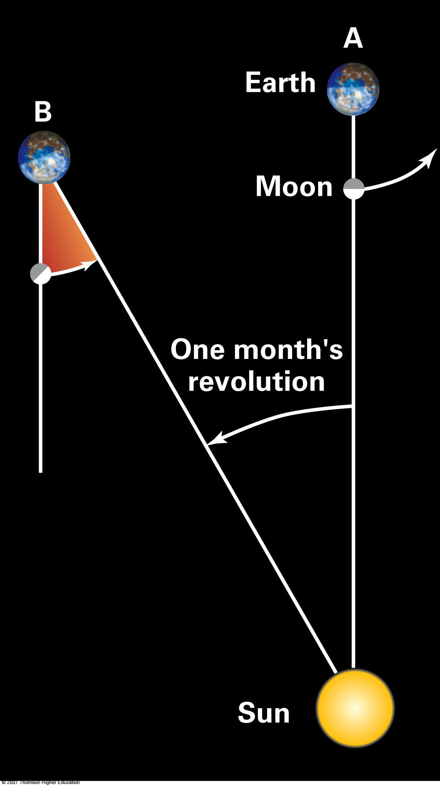
What’s a month?
© Gerard Williger 2023 U Louisville
Depends on how we measure:
Sidereal month: 27.32 days for Moon to go around Earth with respect to stars (=sidereal)
Synodic month: 29.53 days for Moon to return to same PHASE (synodic=same relative positions of Earth, Sun, Moon)
Difference: because Earth travels in its orbit around Sun while Moon goes around Earth!
For same reason: stars rise 4 minutes earlier each day:
“sidereal” day = 23h 56m (relative to stars)
solar day = 24 hrs (relative to sun)
1 yr = 365 solar days = 366 sidereal days = 12.37 synodic months = 13.37 sidereal months
Not to scale!
Notes:
Figure 4.5: After the Moon has completed its 27-1/3 day revolution around the Earth with respect to the stars, it has moved from point A to B. But the Earth has moved one month’s worth around the Sun. It takes about an extra two days for the Moon to complete its revolution around the Earth as measured with respect to the Sun.

Slide 14
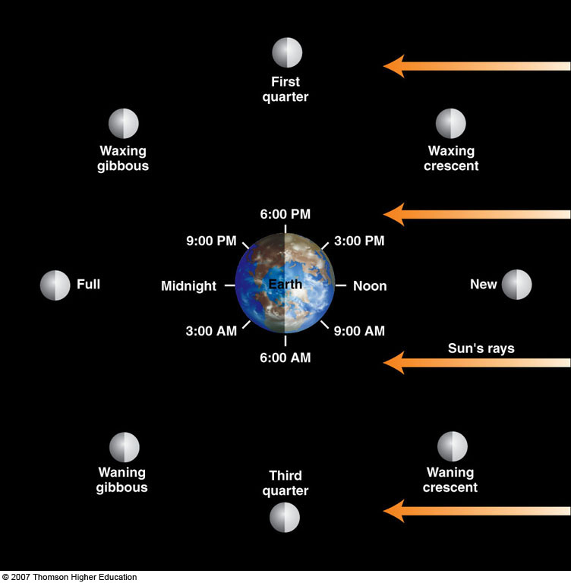
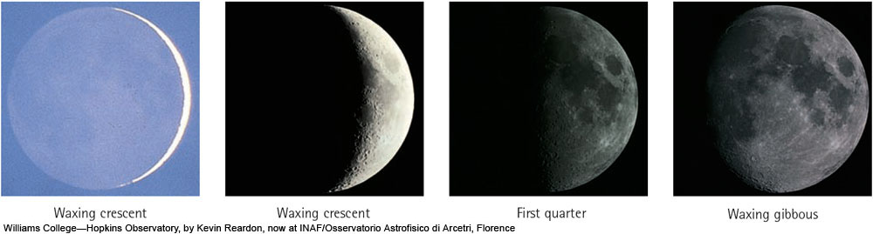
Moon Phases: a question of perspective
© Gerard Williger 2023 U Louisville
From Moon, see Earth phases 180º opposite from Moon’s phase as seen from Earth
Example: from Full Moon, Earth appears New
Not to scale!
FYI 4’ VIDEO: Moon phases, timeanddate.com

Slide 15
Moon phases
© Gerard Williger 2023 U Louisville
Note each position’s name and about when it rises (6 hrs before overhead), is overhead, and sets (6 hours after overhead)
Viewed from above Earth's north pole
c
d
b
First quarter
Waxing crescent
Waxing gibbous
6pm
sunlight
e
9pm
3pm
a
Earth
Midnight
N
noon
New
Full
3am
9am
6am
h
Example: Waning crescent
Rise: 3am
Overhead: 9am
Set: 3pm
f
g
Example: Waning gibbous
Rise: 9pm
Overhead: 3am
Set: 9am
Third quarter
Not to scale!

Slide 16
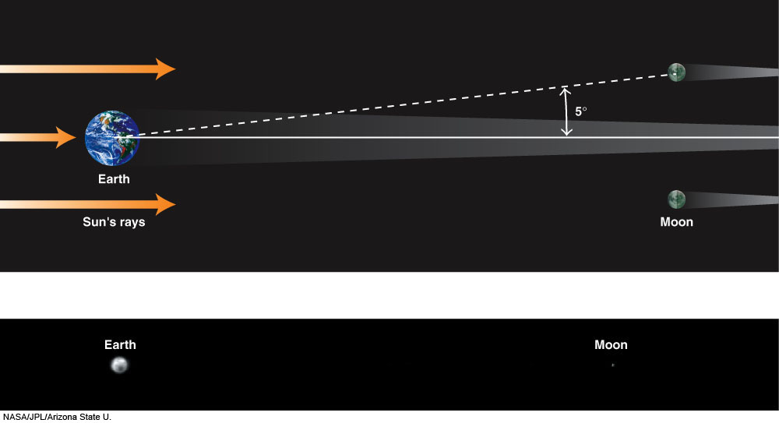
Moon goes in Earth’s shadow
© Gerard Williger 2023 U Louisville
Lunar Eclipses:
Only happens at Full Moon
Not to scale!
Next lunar eclipses visible in KY: 28 Oct 2023 (partial), 24 Mar 2024 (penumbral), 17 Sep 2024 (partial), 13 Mar 2025 (TOTAL), 3 Mar 2026 (total-western US)
True scale: Moon is ~30 Earth diameters away
Part of a lunar eclipse from space, 15” VIDEO, NASA
Moon's orbit is INCLINED by 5 deg with respect to plane of Earth's orbit, so eclipses only possible ~2x per year
Notes:
Figure 4.6: The plane of the Moon’s orbit is tipped by 5º with respect to the plane of the Earth’s orbit, so the Moon usually passes above or below the Earth’s shadow. Therefore, we don’t have lunar eclipses most months. (The diagram is not to scale.) An actual image of the Earth and Moon, illustrating their true separation: about 30 Earth diameters. The image was obtained with the infrared camera on board the 2001 Mars Odyssey spacecraft. Taken at a wavelength of 9 μm, the image shows colder regions, such as the South Pole near the Earth’s bottom, as dark, and Australia, which is warmer, as bright. Each pixel corresponds to 900 km across, about the size of Texas.
NASA/JPL/Arizona State U.

Slide 17
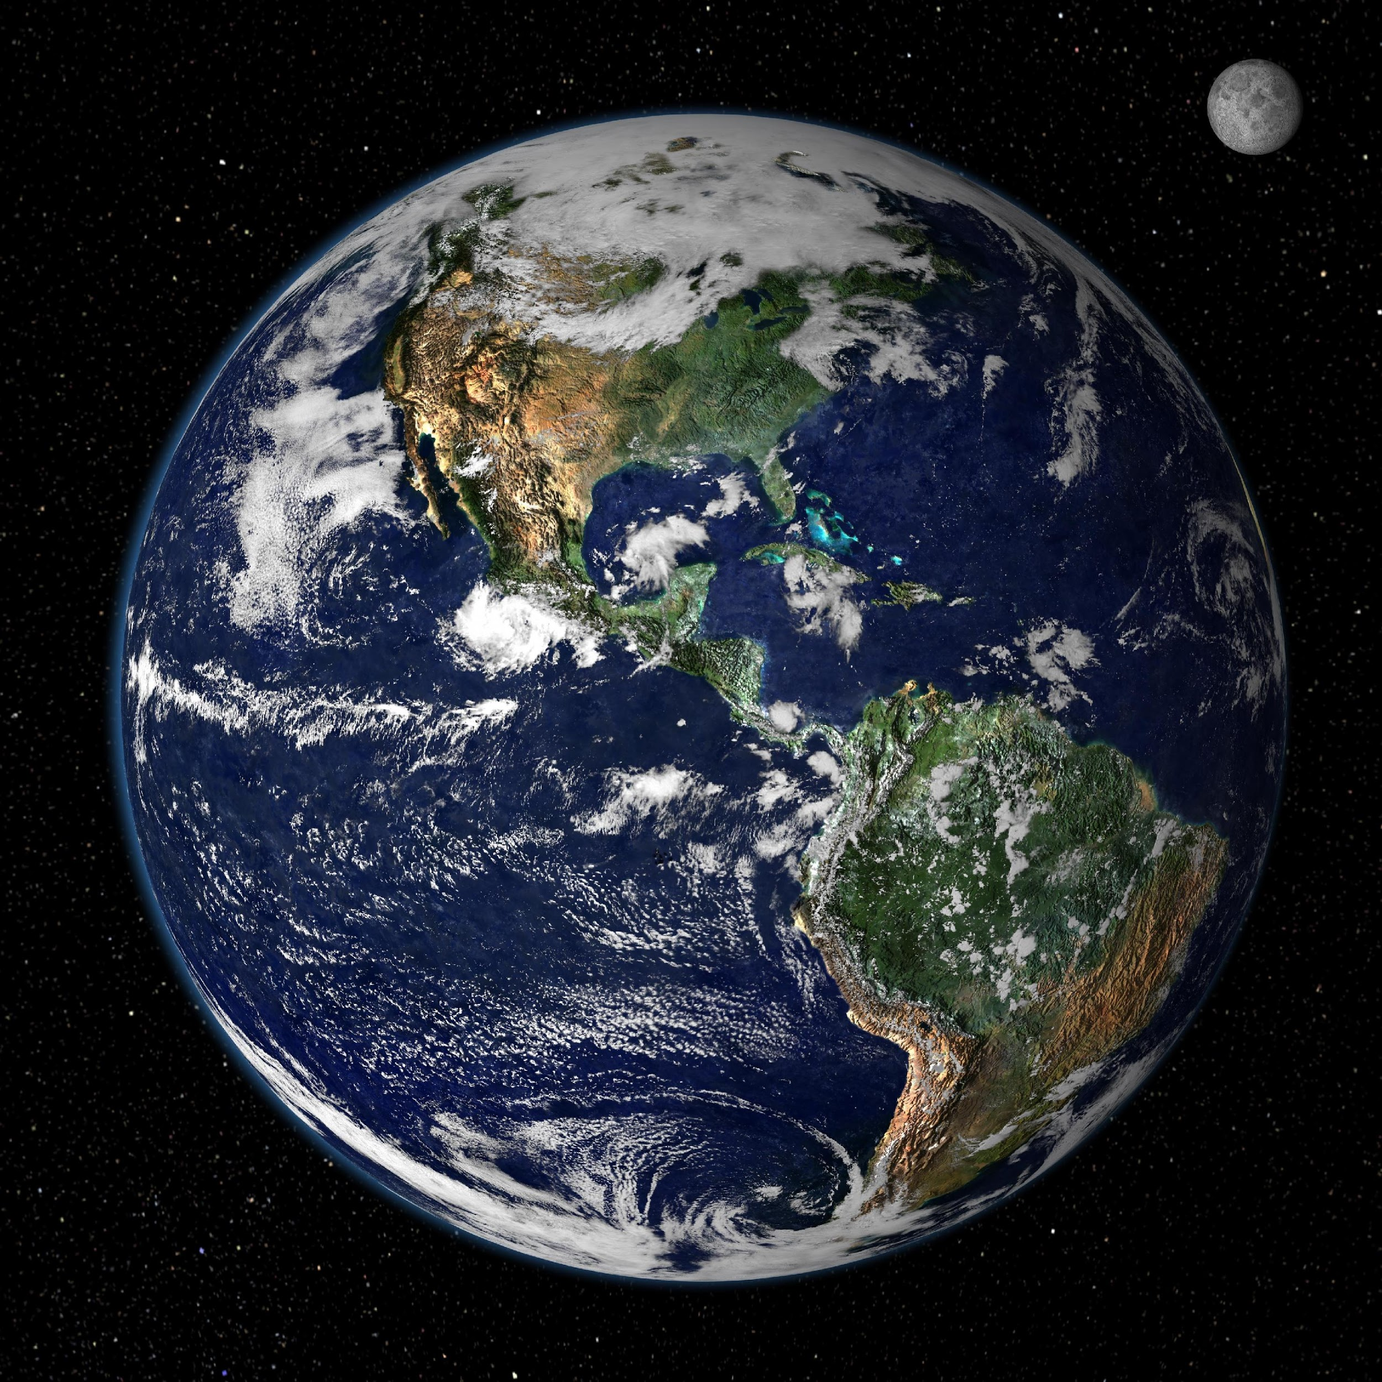
Lunar Eclipses: Happen Often
© Gerard Williger 2023 U Louisville
Size of SUN as seen from Moon: about 0.5 degrees – width of pinky fingernail at arm’s length
As seen from Moon: if Earth is within 1.75 deg of Sun, Earth covers the Sun (if Moon is in right place)
→ Lunar Eclipses common!
Size of EARTH as seen from Moon: about 2 degrees – width of 2 thumbnails at arm’s length

Slide 18
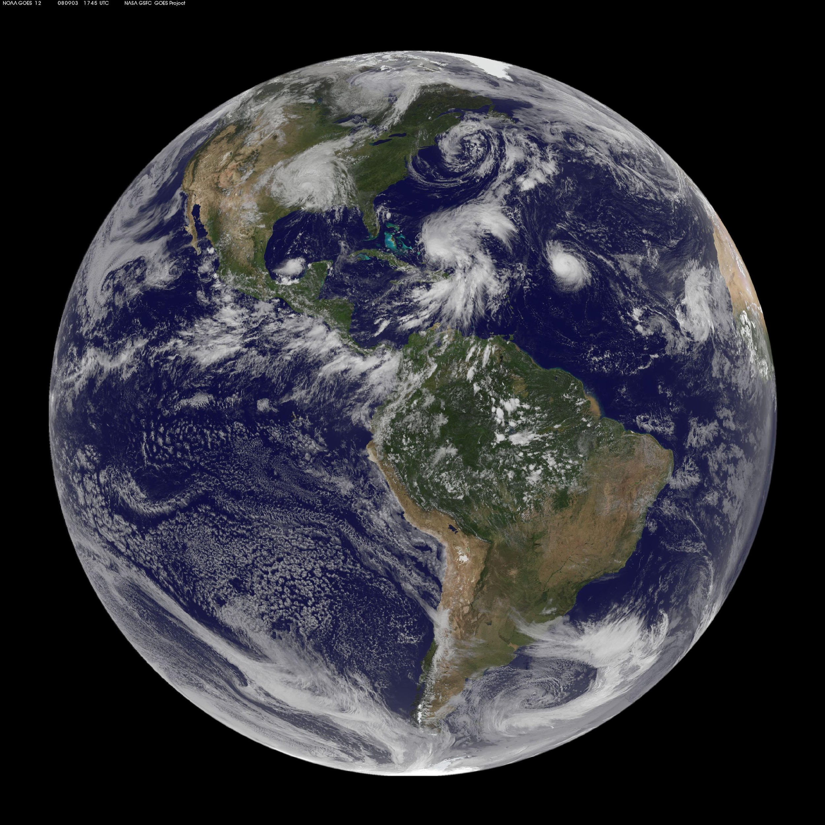
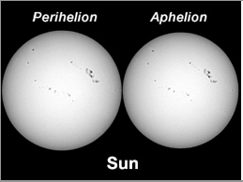
Sun’s and Earth’s angular sizes from Moon
© Gerard Williger 2023 U Louisville
Angular sizes ARE TO SCALE
From Moon at perigee
From Moon at apogee
31.4 arcmin
32.5 arcmin
2.01 deg
1.80 deg
Sun 1% BIGGER when Earth at Perihelion (Jan. 2), 1% SMALLER at Aphelion
Earth appears 5.5% BIGGER at Moon’s Perigee than average, 5.5% SMALLER at Moon’s Apogee
Note: Moon spends LESS TIME near perigee!

Slide 19
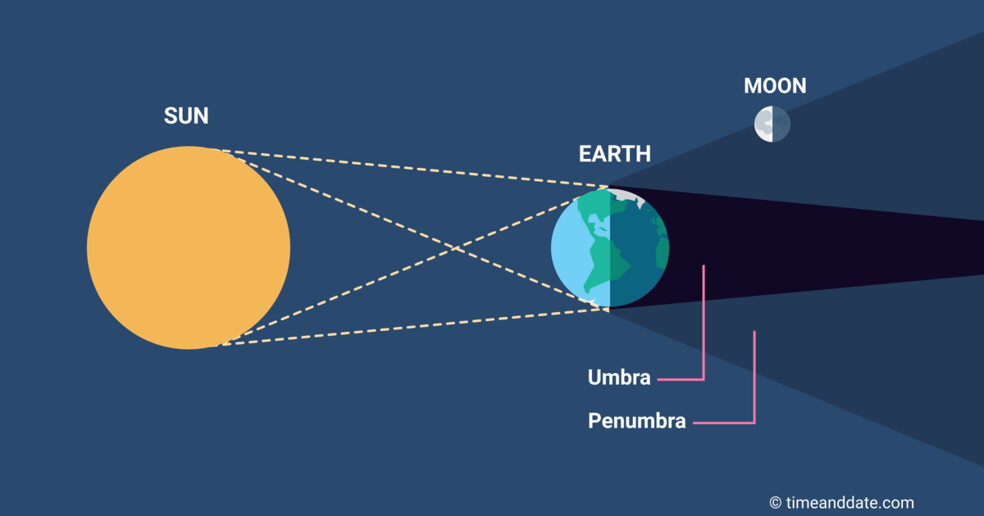
Partial vs. Total Shadows
© Gerard Williger 2023 U Louisville
Sun partially eclipsed
Sun totally eclipsed
Sun partially eclipsed
Not to scale!
Sun is an “EXTENDED SOURCE”, so a planet’s shadow is “cone-shaped”, with an outer “half-shadow”.

Slide 20
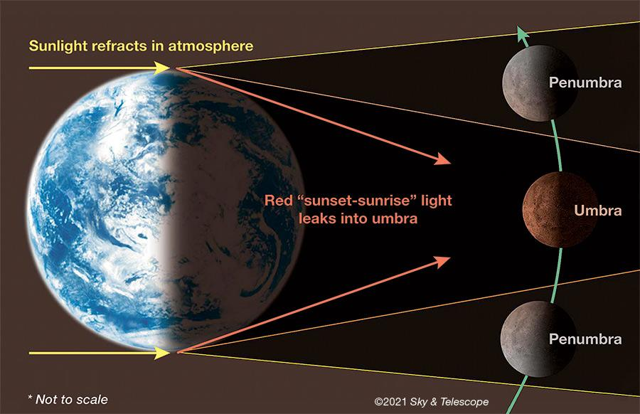
Umbra vs. Penumbra
© Gerard Williger 2023 U Louisville
Lunar Eclipse: visible from ENTIRE NIGHT SIDE of Earth!

Slide 21
Types of Lunar Eclipses
© Gerard Williger 2023 U Louisville
(Partial) Penumbral Eclipse
PART of Moon sees Earth PARTIALLY eclipse Sun
Moon
Penumbral Eclipse
ALL of Moon sees Earth PARTIALLY eclipse Sun
Partial (umbral) Eclipse
PART of Moon sees Earth TOTALLY eclipse Sun
Total (umbral) Eclipse
ALL of Moon sees Earth TOTALLY eclipse Sun
Earth’ Umbra
1.44 deg (at Moon perigee)
1.29 deg (at Moon apogee)
Moon size: 29.4-32.9 arcmin
Looking at Moon from Earth
Angular sizes ARE to scale!
Earth’s Penumbra
2.57-2.31 degrees (apogee vs perigee)

Slide 22
From Moon: Probability of Lunar Eclipse, looking at Earth+Sun
© Gerard Williger 2023 U Louisville
Sun moves ON ecliptic. Earth moves at an ANGLE 5.5∘ from the ecliptic.
v
No lunar eclipse
5.5∘
Earth
Ecliptic
Sun
Total
Penumbral
Partial
We should see a total lunar eclipse about 30% of the time per full moon near line of nodes, at least partial about 40% of the time, when Full Moon occurs while line of nodes points toward Sun.

Slide 23
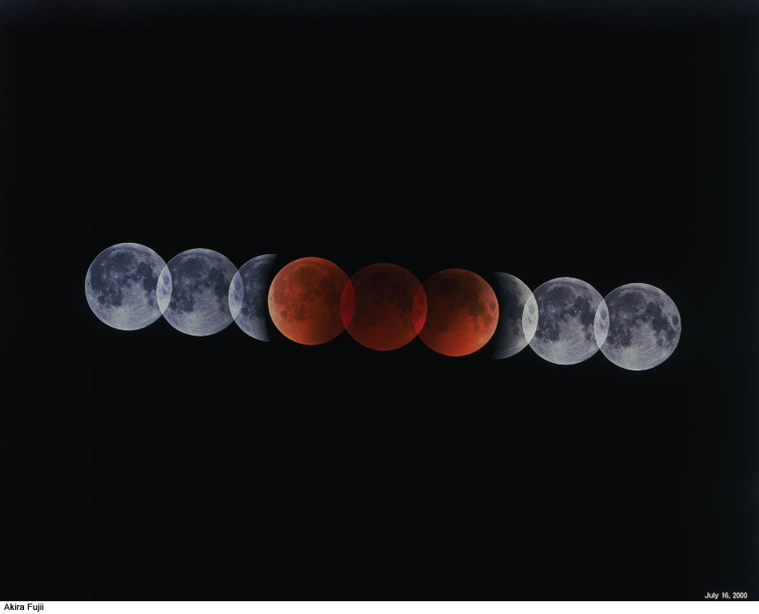
© Gerard Williger 2023 U Louisville
Red color: from light passing through Earth's atmosphere, blue light scatters out
Lunar eclipse takes up to a few hours (Earth’s Penumbra is 5x bigger than Moon)
Moon all in Umbra
Red is from all the sunrises/sets on Earth!
Moon moves its own width each hour against the stars
Moon partly in Umbra
Video 0.5’: NASA simulation
Moon in Penumbra
Every lunar eclipse is different, based on how much dust is in Earth’s atmosphere!
-- darker red or even black after volcanic eruptions, forest fires etc.
Notes:
Figure 4.9a: A total lunar eclipse, showing both partial and total phases. The camera was guided on the position of the Earth’s umbral shadow. Note that the photograph shows that the Earth’s shadow is round, and thus that the Earth is round. The totally eclipsed Moon appears faintly in the center of the shadow and looks reddish.
Akira Fujii

Slide 24
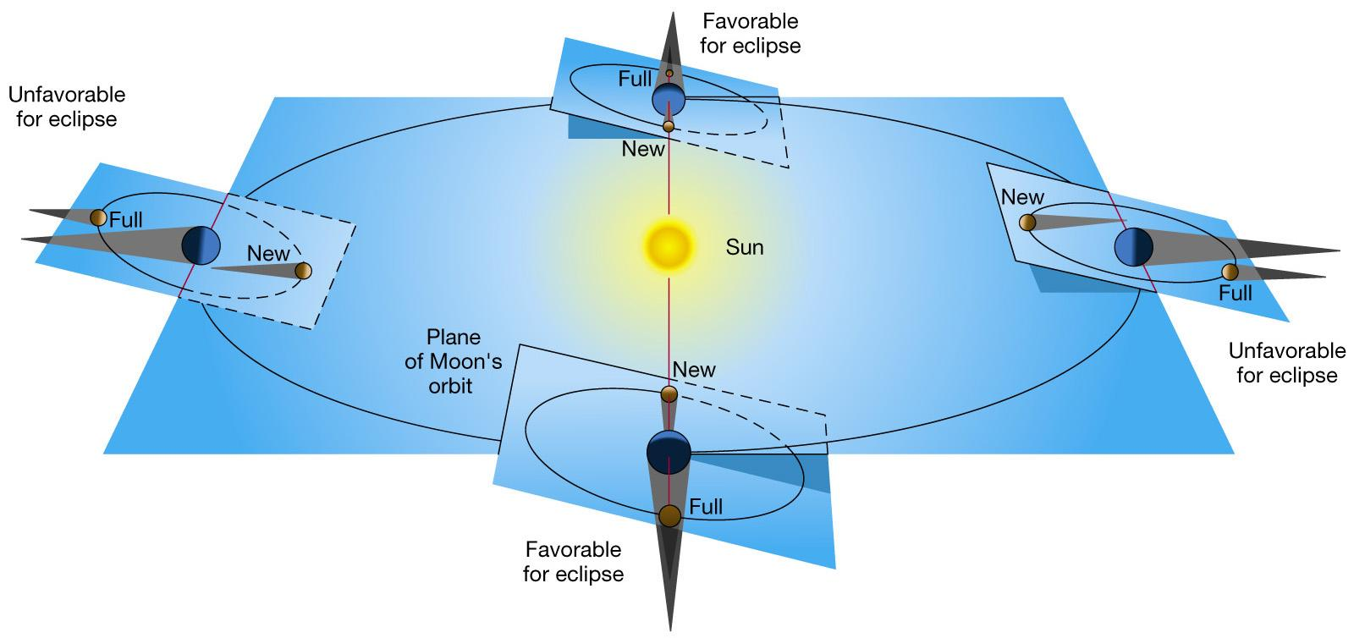
Eclipse Seasons
© Gerard Williger 2023 U Louisville
FYI 1.7’ VIDEO: lunar eclipses (NASA)
ROUGHLY every 6 months, Moon’s orbit’s line of nodes points close enough toward Sun -- eclipse possible, but NOT guaranteed
-- Moon phase: must ALSO be FULL MOON for lunar eclipse!
-- Typically TWO full moons for each semi-annual lunar eclipse season

Slide 25
Some Recent/Future Lunar Eclipses
© Gerard Williger 2023 U Louisville
Oct 28, 2023 – partial
Mar 24, 2024 – penumbral
Sep 18, 2024 – partial
Mar 14, 2025 – total
Sep 7, 2025 – total
Aug 28, 2026 – partial
Feb 19, 2027 – penumbral
Aug 16, 2027 – penumbral
Jan 11, 2028 – partial
Jul 5, 2028 – partial
Dec 31, 2028 – total
Jun 26, 2029 – total
Dec 19, 2029 – total
Check https://www.timeanddate.com/eclipse/list-lunar.html
Dates are approximate for USA – website gives them in Greenwich Mean Time
Next 14 lunar eclipses:
5 total
5 partial
3 penumbral
Average: About 2/year
Remember several types of eclipse are possible:
Moon partially goes into penumbra = PENUMBRAL (very slightly darker)
Moon totally goes into penumbra = PENUMBRAL (a bit more slightly darker)
Moon partially goes into umbra = PARTIAL (see “bite” taken out of Moon)
Moon totally goes into umbra = TOTAL (red color!)

Slide 26
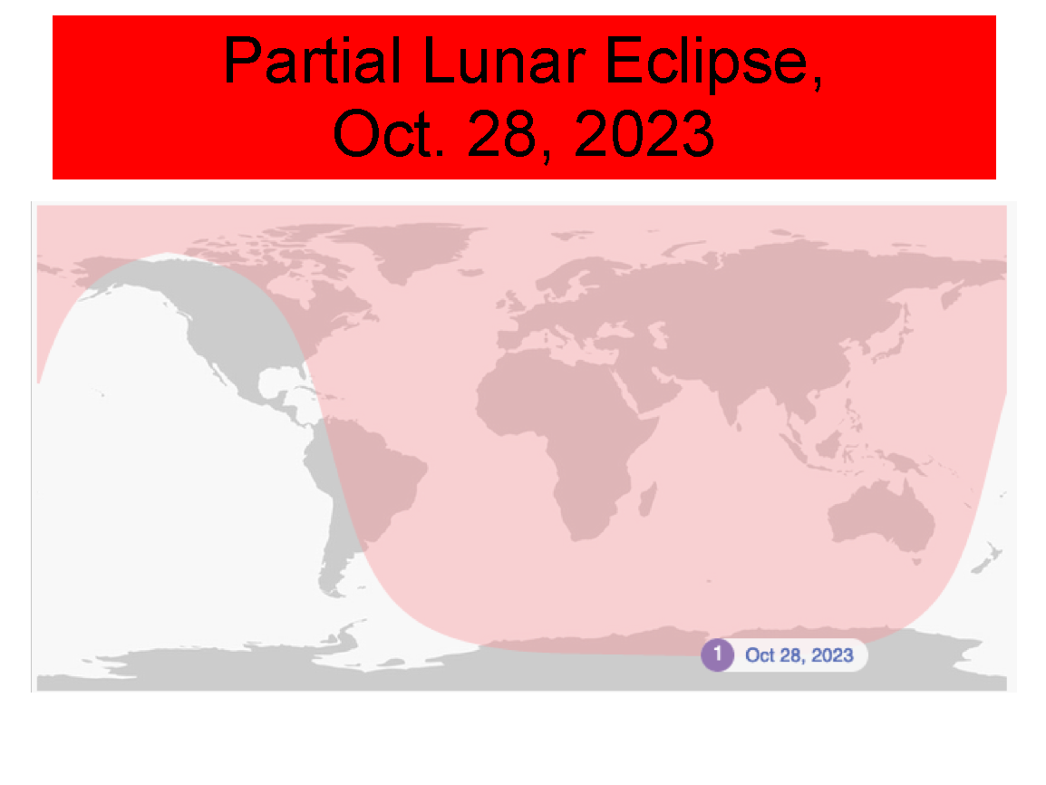
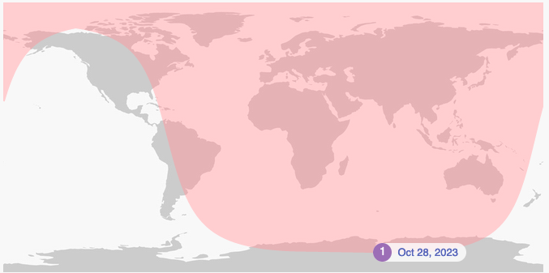
Partial Lunar Eclipse, Oct. 28, 2023
© Gerard Williger 2023 U Louisville
ℒ
Moon will be close to line of nodes – 2 weeks after annular solar eclipse of Oct. 14!

Slide 27
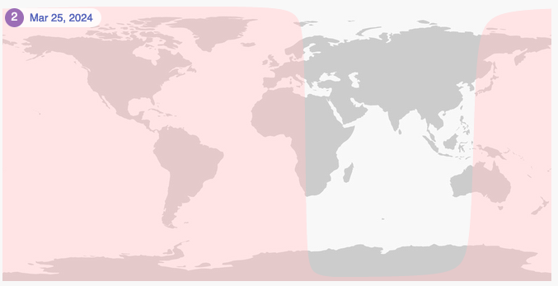
Penumbral Lunar Eclipse, Mar. 25, 2024
© Gerard Williger 2023 U Louisville
ℒ
Moon will be close to line of nodes – 2 weeks BEFORE TOTAL solar eclipse of Apr. 8!

Slide 28
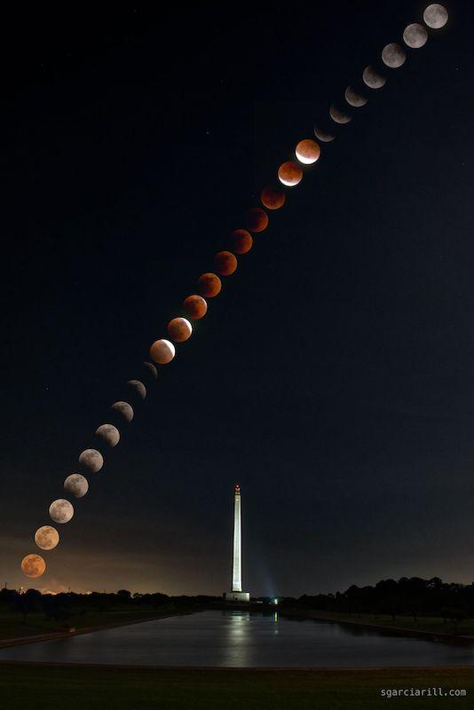
Lunar Eclipse May 15-16, 2022
© Gerard Williger 2023 U Louisville
San Jacinto Monument, La Porte TX. Individual images with 850mm (telephoto) lens, resized, overlaid with an image of the monument, using Photoshop.
Sergio Garcia Rill.
From earthsky.org, Nov. 22, 2022

Slide 29
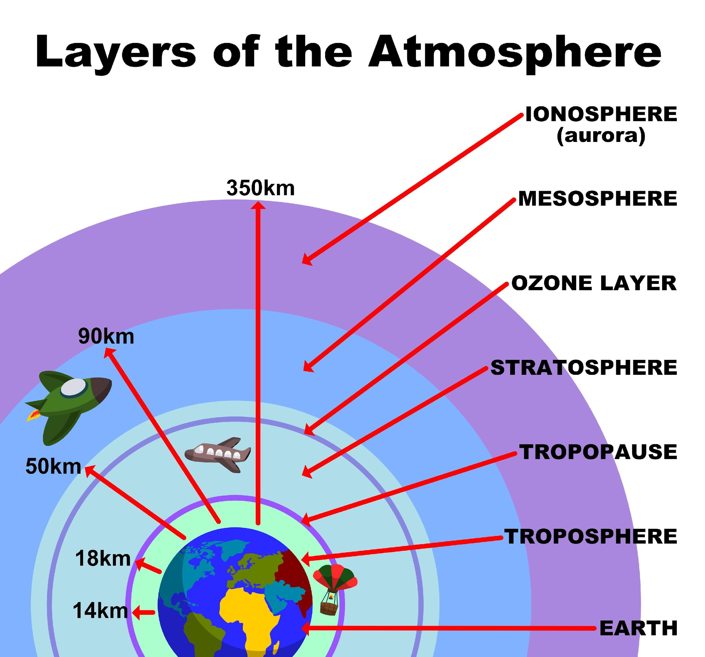
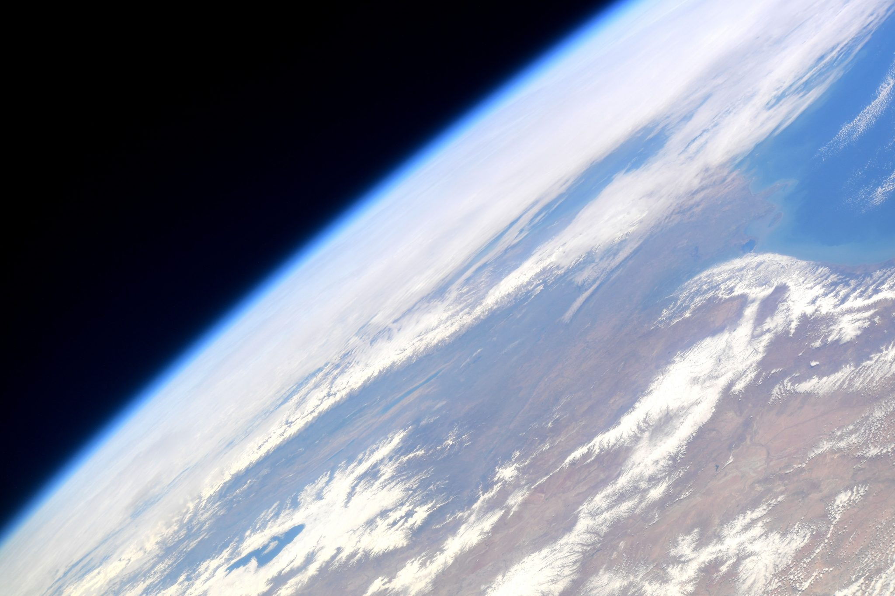
Rare Effect: Blue (Ozone) Band - I
© Gerard Williger 2023 U Louisville
THIS is to scale!
Not to scale!

Slide 30
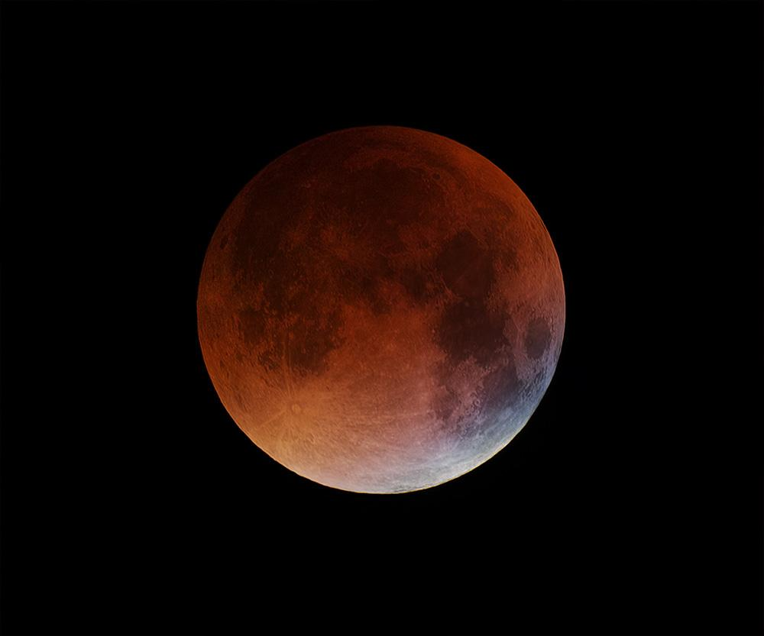
Rare Effect: Blue (Ozone) Band - II
© Gerard Williger 2023 U Louisville
Sep 28, 2015, by Giuseppe Petricca, Pisa, Italy, 2 minutes before totality. Blue band is from sunlight passing through Earth’s narrow ozone layer (absorbs UV + red light).
Blue band

Slide 31
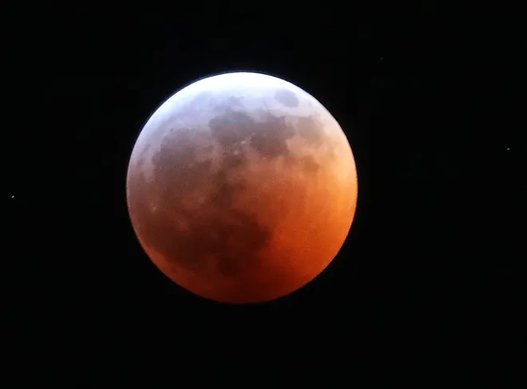
SUMMARY
© Gerard Williger 2023 U Louisville
Lunar Eclipses occur at Full Moon
Visible from WHOLE night side of Earth
Occur about 2x/year
3 main types: total, partial, penumbral
Red glow due to Earth’s atmosphere (all the sunrises/sunsets in world)
Enjoy the next one visible to you!
Lunar Eclipse, Mike De Sesti, 2019 Jan 21, Milwaukee Journal-Sentinel
Summary 3.3’ video, Nat’l Geographic

